Slide 1
Deans’ and Behavior Coaches
In-Service
Notes:
Go over the agenda and first part of the manual

Slide 2
Active Shooter Protocols
Staying Prepared
Presented by the Pensacola Police Department
Notes:
Introduce Sgt. Bauer, Officer McKenzie, and Officer McClean

Slide 3

10 Minute Break
Notes:
Tell them where the restrooms are located and let them know where the teacher’s lounge is located.

Slide 4


CHANGE
Good Change
Bad Change
Notes:
We live in changing times, and they are changing quicker than ever before.
We need to embrace good change and move away from the bad.
Good change represents creativity and Bad Change represents stagnation.
We as educators must remain flexible and adapt to the challenges that face us.

Slide 5
Who Moved My Cheese
https://www.youtube.com/watch?v=16hxCB1Dvd4
Notes:
This is a 15 minute video. It is about change, and the different way individuals adapt to change. I want you to watch and think about the people you encounter at your school and see where most of them fall. I also want you to think about yourself and see which category you fall in. We will discuss this briefly at the end of the video.

Slide 6
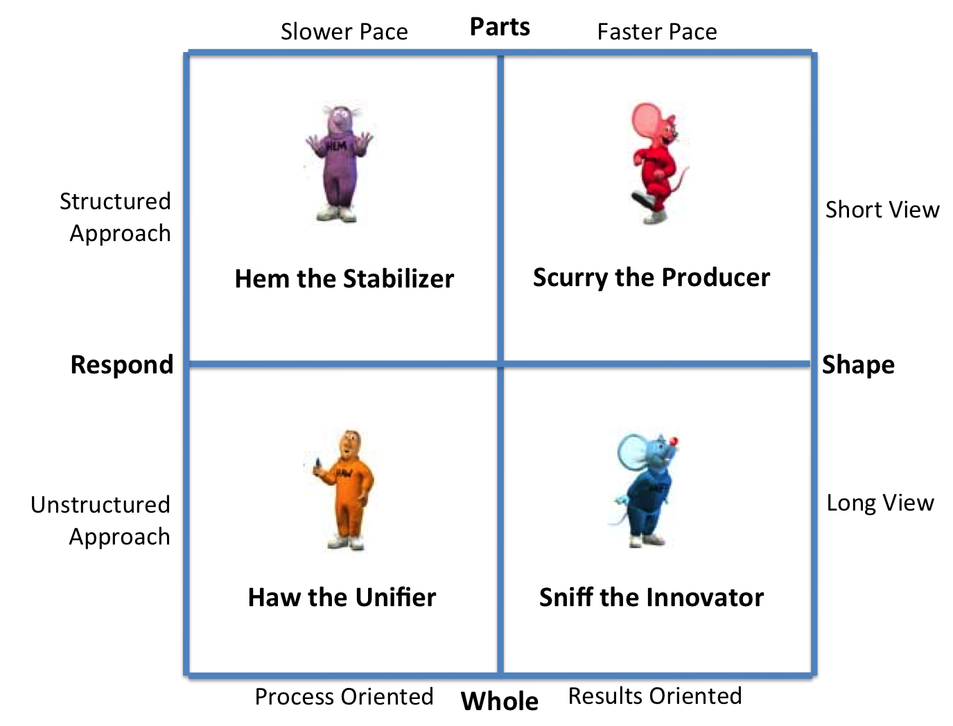
How does Change Effect You
Notes:
Look at this table, where do the majority of the staff at your schools fall. If they are sniff or scurry you are going to have a fast paced innovative school. The teachers are going to go above and beyond to make change happen. If they are Haw, you are going to have to show them the way at first, and be patient, but eventually they will come along with changes. If they are HEM, you have a hard road ahead of you. They believe nothing should ever change, because what worked in the past, should still work today. It is not them, it is everyone else.

Slide 7
Attitude Matters
https://www.youtube.com/watch?v=5zbKSR6p4rY
Notes:
This short video is called the Pep talk by Kid President. I want you to watch it and be ready to discuss it at the end of the video.

Slide 8

Attitude Matters
Please read the article in your folder entitled
“Kid President”: A boy easily broken teaching how to be strong.
Notes:
Have them read the article.
Questions:
What stands out to you about Kid President now?
He could be angry about his situation but instead he chooses to focus on the positives. In your jobs it is easy to always focus on the negative, we have to change that around and focus on the positives. That means how can you take a crisis moment for a student, and their parent and turn it around for the good. It does not mean their will not be consequences for the student. How can you help them turn it around for good?

Slide 9
2015-2016
New Documents
Notes:
The court liaison’s office has created several new documents for schools to use this year. They will all be sent electronically to the schools via e-mail to you and your principals. Please use these when preparing removal documentation this coming school year. A copy of each document will be talking about is in your folder.

Slide 10
New Documents
Removal Hearing checklist
BTWHS Expulsion and Disciplinary Re-assignment Check-off List.pdf
Investigations Template
BTWHS Investigation Report and Findings.pdf
RTI-B/Discipline committee letter
RTI-B Lettter 1.pdf
Notes:
Go over each document and its proper usage.

Slide 11
New Documents Continued
RTI-B Student Discipline Review Meeting SOP
SOP RTI-B.docx
Principal’s Removal Letter
BTWHS Removal letter.pdf
Notes:
Go over each document and its proper usage.

Slide 12
2015-2016
R and R Handbook
Notes:
This is an entirely new document this year and has an entirely different look from years past.
Please read it and be familiar with it.
Take your time going over it with your students.

Slide 13
Rights and Responsibilities Handbook Changes
New Section called frequently asked questions.
Elimination of vacations being automatic unexcused absences.
Student Right’s and Due process (new terminology)
Dress Code
Notes:
Go over each of these parts

Slide 14
Student Rights’ vs. Due Process
Student Rights’
The student will be informed orally and in writing.
The student will be allowed to present his or her version of the event.
If the student claims innocence or chooses not to speak the evidence against him/her will be explained.
All evidence will be considered by the principal/designee.
The severity of the charge and progressive discipline will determine the punishment within the DIM.
Due Process
Only applies to suspensions in excess of 10 days.
Requirements in this situation are:
  Right to legal counsel
  Right to cross examine witnesses
  Right to call witnesses
  Official notice of charges
  Opportunity to be heard
Notes:
Please use the proper terminology when discussing this with parents.
Only use due process in the situation that is explained. Suspension in excess of 10 days.

Slide 15
2015-2016
District Intervention Matrix

Slide 16
DIM
No changes to the DIM
Remember to always make contact with the parent/guardian
PBS schools may advance one to two steps if behavior tracking forms have been completed properly and parents have been contacted.
All other schools must follow the guidelines as written taking progressive discipline into consideration with all referrals.
Notes:
Please know that this is now published in the R and R handbook.
Parents will read this, they will want you to explain why you given then a more severe consequence than what is listed.
Be prepared with an answer. (previous interventions, progressive discipline, behavior tracking forms, etc.)

Slide 17
2015-2016
School Investigations

Slide 18
School Investigations
Investigations template
Use the template for major Investigations in which the school is going to proceed with removal (i.e. Drugs, Weapons, Bomb Threat, Major cases of sexual misconduct, Major disruptive fights, etc.)
This information is extremely valuable in a removal hearing.
Notes:
Use the template in these situations. It will bring uniformity to the process and give the school a stronger standing in the removal hearings.

Slide 19
2015-2016
Arrests and Police Investigations

Slide 20
Arrests and Police Investigations
Remember that schools do not have the power to arrest anyone. Only law enforcement can make an arrest. They do so based on what they see are the facts and evidence of the case before them.
Remember to always attempt to call and notify the parent or guardian of any student suspect that is going to be interviewed by an LEO prior to the interview taking place. (In matters of urgent public safety this may not happen before the interview takes place.)
These calls should always be documented.
Notes:
Please mark only reported to law enforcement , not arrest, unless the arrest actually took place on campus. If the SRO issues a warrant it is not an arrest until it is served. You will need to go back into focus upon receiving arrest notification from our office and mark arrest. This only applies to an arrest that happened as a result of an offense on campus.

Slide 21
2015-2016
Bullying

Slide 22
Bullying
Bullying means systematically and chronically (repeatedly) inflicting physical hurt or psychological distress on one or more students or employees. It is further defined as unwanted and repeated written, verbal, or physical behavior, including any threatening, insulting, or dehumanizing gesture by a student or adult that is severe or pervasive enough to create an intimidating, hostile, or offensive educational environment; cause discomfort or humiliation; or unreasonably interfere with the individual’s school performance or participation which may involve, but is not limited to, the following:
Notes:
If a teacher or student indicates bullying or harassment. Per chapter 7 of the school board rules and investigation must take place. If found to be unfounded, all parties must still be notified. If founded, parties must be notified and a corrective action plan must be put in place for the student or students that are bullying. This plan must be monitored with fidelity.

Slide 23
Bullying Continued
1. unwanted teasing;
2. social exclusion;
3. threat;
4. intimidation;
5. stalking;
6. physical violence;
7. theft;
8. sexual, religious, or racial harassment;
9. public humiliation; and
10. destruction of property.

Slide 24
Harassment
Harassment means any threatening, insulting, or dehumanizing gesture, use of data or computer software, or written, verbal or physical conduct directed against a student or school employee that
  1. places a student or school employee in reasonable fear of harm to his or her person or damage to his or her property;
  2. has the effect of substantially interfering with a student’s educational performance, opportunities, or benefits; or
  3. has the effect of substantially disrupting the orderly operation of a school.

Slide 25
Reporting
Please read pages 4-10 of chapter 7 of the school board policy on bullying and harassment.
Reporting must be taken seriously.
  Reports must be immediately investigated.
  Steps taken towards resolution and consequences documented.
  The appropriate parties must be called within the time allotted.

Slide 26
Education
We must educate our students and staff on what the true definitions of bullying and harassment are.
New bullying reporting app (if you witness or receive complaint it your responsibility to report it)
We are asking that the deans add this component to their preschool agenda for teachers and beginning of the year presentations to students.

Slide 27
SESIR and Bullying
Accurate Reporting
Presented by Kerri Coots and Dr. Michael Samala

Slide 28
What is Bullying?
https://youtu.be/zUAbAKee0Cw

Slide 29
Second Chance
Slaying dragons: a pathway to success
Presented by Ladon Boyd

Slide 30

Lunch
Return
by 1:15p.m.

Slide 31
Dealing with students with Differences
Working together to solve big problems
Presented by: Donna Perry and Traci Kent

Slide 32
Dealing with Differences
RTI/ MTSS
FBA/ PBIP
Risk Assessment
Donna Perry
E/BD Program Specialist
469-5523

Slide 33
Response to Intervention/ Multi Tiered Systems of Support
Has evolved out of the shift from screening for disabilities to improved outcomes for all students
Has resulted in improved assessment and intervention for all students
The multi-tiered system involves the systematic use of multi-source assessment data to most efficiently allocate resources in order to improve learning for all students, through integrated academic and behavioral supports.

Slide 34
MTSS
Florida's Multi-tiered System of Support website provides a central, comprehensive location for Florida-specific information and resources that promote system-wide practices to ensure highest possible student achievement in both academic and behavioral pursuits. http://florida-rti.org/index.htm.

Slide 35

RTI vs. SWPBS
RTI & RTIb= closing the achievement gap whether academic or behavioral/social achievement.
SWPBS= improving general school discipline and classroom management

Slide 36
RTI/ RTIb
We can effectively teach all students
Intervene early
Research Based- Scientifically Validated academic and/or behavioral interventions
Data Driven Decision Making
3 Tiers
  1 Universal: classroom based available to all students
  2 Universal + Supplemental: small group interventions
  3 Universal + Supplemental + Intensive: individualized/ intensive interventions (FBA/ PBIP for behavior)
  Sugai & Horner (2009)

Slide 37
SWPBS
Define and teach pro social behaviors
Acknowledge and reinforce pro social behaviors
Arrange consistent consequences for problem behaviors
Data Driven Decision Making
3 Tiers:
  1 Universal: school wide social skills curriculum, expectations, reinforcement system, and continuum of consequences.
  2 Universal + Supplemental: small group interventions for students who are not responding to Universal supports
  3- Universal + Supplemental + Intensive: highly individualized Functional Behavior Assessments and Behavior Intervention Plans
  (Robertson et al. 2007)

Slide 38
Tier 1 Interventions for all Students
Assessment Progress Monitoring of Benchmarks
Mastery
Grade
Level
Learner
Struggling Learners Who Have
Experienced
No Previous
Tier 2 Interventions
Tier 2
Interventions
Without
Success
Tier 3
Interventions
Without
Success
Tier 2
Interventions 9-12
weeks
Tier 3
Interventions
6-9 weeks
Formal
Evaluation for
Possible
Special Education
At any Tier when a student demonstrates success they
Return to Tier 1 Interventions

Slide 39
Tier 1 Interventions for all Students
Assessment Progress Monitoring of Behavioral
Expectations
Mastery
Student Meeting
School Wide
Expectations
Students demonstrating problem
Behaviors who have experienced
No Previous
Tier 2 Interventions
Previous
Tier 2 Interventions
Without
success
Previous
Tier 3 Interventions
Without success
Tier 2
Interventions
ERASE 9-12
Weeks
Tier 3
Interventions
FBA
/ PBIP 9-12
weeks
Formal Evaluation
For possible
Special
Education
At any Tier when a student demonstrates success they
Return to Tier 1 Interventions

Slide 40
FBA/ PBIP
Section 1414(d)(3)(B)(i-v) addresses the role of the IEP team in considering special factors. Part (i)
states that the practitioner should
“in the case of a child whose behavior impedes his or her learning or that of others, consider,
when appropriate, strategies, including positive behavioral interventions, strategies, and supports
to address that behavior.”

Slide 41
Legal Requirements
Procedural safeguards are delineated in Section 1415. Specifically, Sections 1415(k)(1)(A)(i-ii) and (B)(i-ii) outline the requirements for placements in alternative educational settings, another setting, or suspension as a result of disciplinary action. Part (B)(i) and Part (B)(ii) state, “If the local educational agency did not conduct a functional behavioral assessment and implement a behavioral intervention plan for such child before the behavior that resulted in the
suspension...the agency shall convene an IEP meeting to develop an assessment plan to address that behavior; or if the child already has a behavioral intervention plan, the IEP Team shall review the plan and modify it, as necessary, to address the behavior

Slide 42
What is a FBA?
What is a functional behavioral assessment?
A functional behavioral assessment is a process for developing a useful understanding of how behavior
relates to the environment. By knowing the function (or purpose) that the behavior serves for the student,
one is able to develop an intervention that also serves that purpose, but does so through positive student
behaviors. Intervention strategies may include effective prevention, remediation, or development of
alternative behaviors (replacement behaviors). Therefore, similar behaviors should not routinely be
treated with identical interventions, as the functions of the behaviors may be very different. For example,
one student may fight to stop teasing by a peer; another student may fight to gain approval from a peer group

Slide 43
When?
Based on Section 1415(k)(1)(B) of IDEA and on 34 C.F.R. 300.519, if a disciplinary action is being considered for a student with a disability that would result in a change of placement
one of the following must have been completed by the IEP team either before or not later than 10 days after taking the disciplinary action:
development of a plan for conducting an FBA and development of interim interventions
review of the student’s behavioral intervention plan that has already been developed and modification of the plan as necessary to address the student’s behavior
Additionally, as part of the MTSS process for students who may be considered for Special Education services in programs such as E/BD or ASD an FBA is a required component.

Slide 44
Is an FBA only for ESE students?
Best practice suggests that a functional behavioral assessment be conducted for a student whenever behavior appears to be significantly interfering with the learning process and well before behaviors reach crisis proportions.
As part of the MTSS process for students who may be considered for Special Education services in programs such as E/BD or ASD an FBA is a required component.

Slide 45
Positive Behavior Intervention Plan
Now that you have the FBA what do you do with all that information?

Slide 46
PBIP
Include the parent or guardian (and the student, as appropriate) of the plan.
The plan needs to be practical, workable, and reasonable for implementation in the targeted settings.
Train those who will implement the plan.
Interventions that are considered should use the following approaches:
– adjust environment to prevent problems and promote positive behaviors
– teach skills to a high level of competency (often referred to as replacement behaviors) that allow the student to achieve the same results as the problem behavior
– manage consequences so that reinforcement is maximized for positive behaviors and minimized for problem behaviors
Well-designed class wide interventions may be very appropriate for some students; however, other children may require well-crafted, individualized interventions.

Slide 47

Understanding Students with Emotional Behavioral Disabilities
(E/BD)

Slide 48

Statistics
18-21% of children and adolescents have behavioral, emotional, or mental health problems
6-10% school-aged children have a documented need to have their social/emotional needs supported in school
Three million American children meet the clinical criteria for mood disorders

Slide 49

Living with E/BD
E/BD impacts a person's ability to effectively recognize, interpret and express fundamental emotions

Slide 50
What You May See…
Poor ability to build or maintain satisfactory relationships with peers, teachers, other adults in the school setting; or
Behaviors that are chronic and disruptive such as noncompliance, verbal and/or physical aggression, and/or poorly developed social skills

Slide 51

Perception:
Bad
Angry
In need of discipline
Moody
Selfish
Just want attention

Slide 52
Contributing Factors to Emotional and Behavioral Problems
Biological Factors
Family Factors
School Factors
Community Factors

Slide 53

Biological Factors
Known genetic links to:
Depression
Schizophrenia
Nutritional deficits which manifest in behavior problems
Some other neurological conditions which manifest as behavior problems

Slide 54

Family Factors
Living Environment
Physical Abuse
Child Neglect
Sexual Abuse
Emotional Maltreatment

Slide 55

School Factors
Tend to underachieve in school
Learning problems cause disadvantages in school environment
Lack of social skills result in social rejections by both teachers and peers
Rejections lead to disinterest in school and greater underachievement

Slide 56
Community Factors
Exposure to stressors within the community
Exposures to crime and violence

Slide 57
IMPACT OF E/BD
May withdraw or isolate from others; no/little interaction with peers and adults
May appear sad and/or cry easily
May elope (run) from an “uncomfortable” social situation
May avoid interaction with others due to fears and phobias
May display social skills that are immature

Slide 58
IMPACT OF E/BD (cont’d)
Difficulty communicating and expressing themselves appropriately
May perseverate on or “not let go” of an issue (particularly issues related to fairness),
May seem paranoid
May display self-injurious behaviors (hitting, cutting, picking, hair pulling, etc.)
May process information based on thoughts and feelings that are inconsistent with actual events or circumstances

Slide 59
IMPACT OF E/BD (cont’d)
May become overwhelmed by a task
May be disorganized
May display verbal and/or physical aggression

Slide 60
Things to Keep in Mind…
Many times we are unaware of
the trauma our students have been through or are still going through
Many times we inadvertently trigger behaviors through how we interact with students
Much can be done to think about the environment we are creating and how it impacts our students

Slide 61

When these kids go to school they…
Feel insecure
Feel uncertain
Feel nervous
Feel scared
Can’t “regulate their emotions”
Have poor self-concept
Struggle in school
Feel helpless
Feel hopeless
61
Notes:
Modeling of how to regulate one’s emotions, has not occurred.

Slide 62
When severely traumatized, the child’s “mental model” of the world suggests
that it is a hostile and dangerous place in which they are not protected or
loved, but alone in their distress. Their “mental model” helps them to survive
in the short run, but can cause extreme and maladaptive ways of coping
over time.

Slide 63
How does Trauma Affect Learning?
Poor relationships with peers and teachers
More likely to repeat a grade
More likely to be placed in special education classes
Suspended and expelled more often
Speech and language difficulties
Difficulty concentrating
Lower academic achievement
Lower test scores
More likely to drop out of school

Slide 64
Trauma-Informed Care
Trauma-informed care is a/n (compassionate) approach to engaging people with histories of trauma, that recognizes the presence of trauma symptoms and acknowledges the role that trauma has played in their lives.
    SAMHSA National Center for Trauma-Informed Care
64

Slide 65
So, what can we do about it ?
According to research, schools can provide effective supports to traumatized students.
All successful children possess three common traits (protective factors, assets) whether or not they had experienced trauma.
  Good cognitive skills/initiative
  The ability to “Self-Regulate”
  A strong adult-child relationship

Slide 66

Important Things We Can Do
Make Students feel safe and secure
  Create positive classroom/school environments
  Create relationships/connections
  Teach students about the impact of stress
  Teach self-regulation skills
Notes:
Plug for Zones of Regulation Curriculum
Maintain a highly structured, safe environment
Develop a predictable and consistent routine
Set clear, firm, consistent limits for inappropriate behavior
Enforce consequences consistently
Recognize that behavioral problems may be related to trauma
What are the “triggers”?
Give “warning” if something out of the ordinary is about to occur (lights out, etc.)
BE TRAUMA INFORMED

Slide 67
Threat Assessment
Risk Assessment Planning…

Slide 68
References
Functional Behavioral Assessment and Behavioral Intervention Plans Technical Assistance Paper www.fldoe.org
Hodas MD, G. (Ed.). (2006). Responding to childhood trauma: the promise and practice of trauma informed care. Pennsylvania: Office of Mental Health and Substance Abuse.
The National Center for Trauma Informed Care (NCTIC) www.nasmhpd.org

